Slide 1

Spotify Dashboard Analysis

Slide 2

Introduction
Spotify is one of the largest music streaming platforms with millions of active users worldwide.
It offers personalized playlists, podcasts, and data-driven recommendations.
Streaming patterns impact artists ranking. revenue generation, and marketing strategies.
A data-driven approach helps in understanding audience engagement and preferences.

Slide 3
Benefits of the Dashboard
Trend Identification
Audience Insights
Marketing Optimization

Slide 4
Data Description
Dataset Overview
Data Processing Steps
Data Extraction
Source: Spotify Streaming Dataset
Time Period: Daily
Key Attributes:
Track Name
Artist
Streams
Track Position
Date
Country
Data Cleaning
Transformation
Visualization

Slide 5
Components of the Dashboard
Bar charts
Line charts
Area Chart
Maps
Navigation Buttons
Filters & Dropdowns

Slide 6
KPIs
Total Streams: Overall number of streams recorded.
Average Streams per Track: Mean streams per song.Track
Retention: Measures how long a song remains in the top charts.

Slide 7
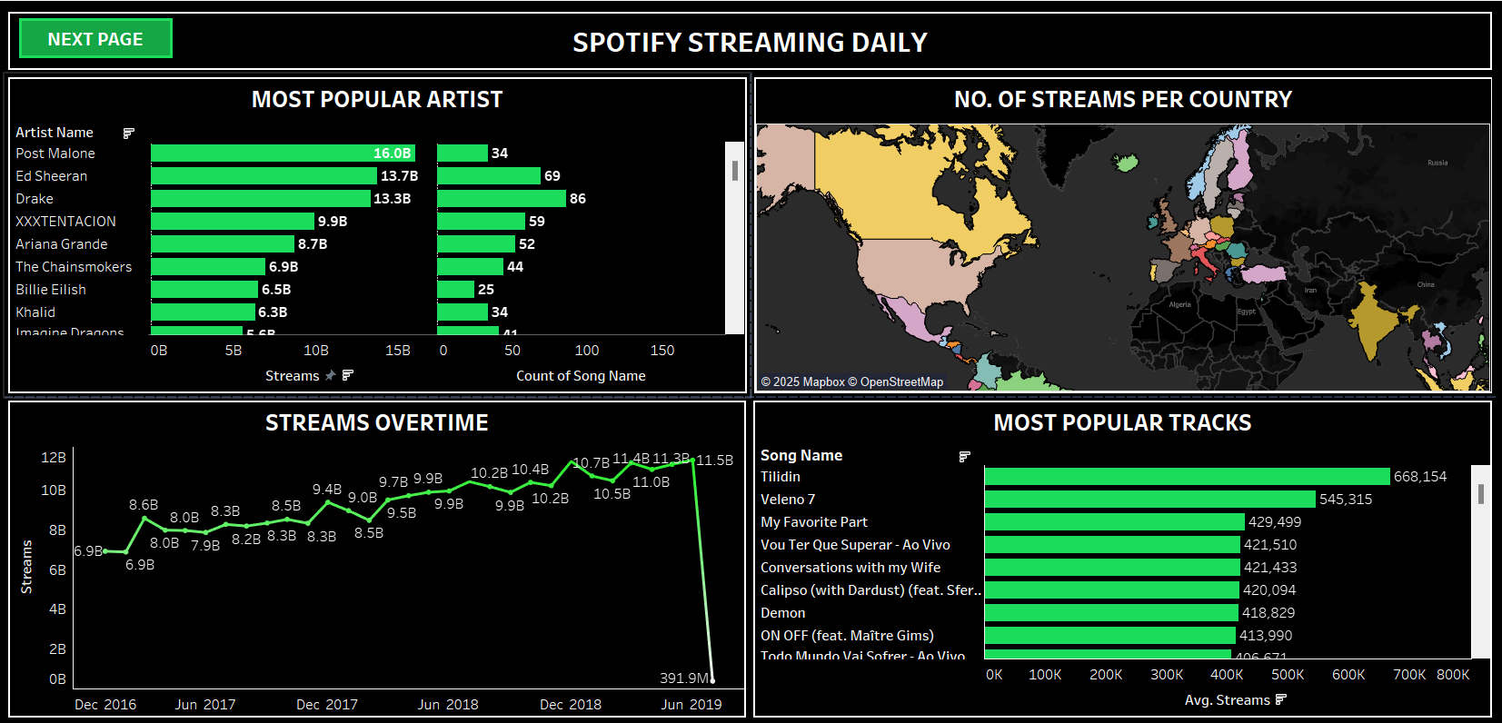
Visualization

Slide 8
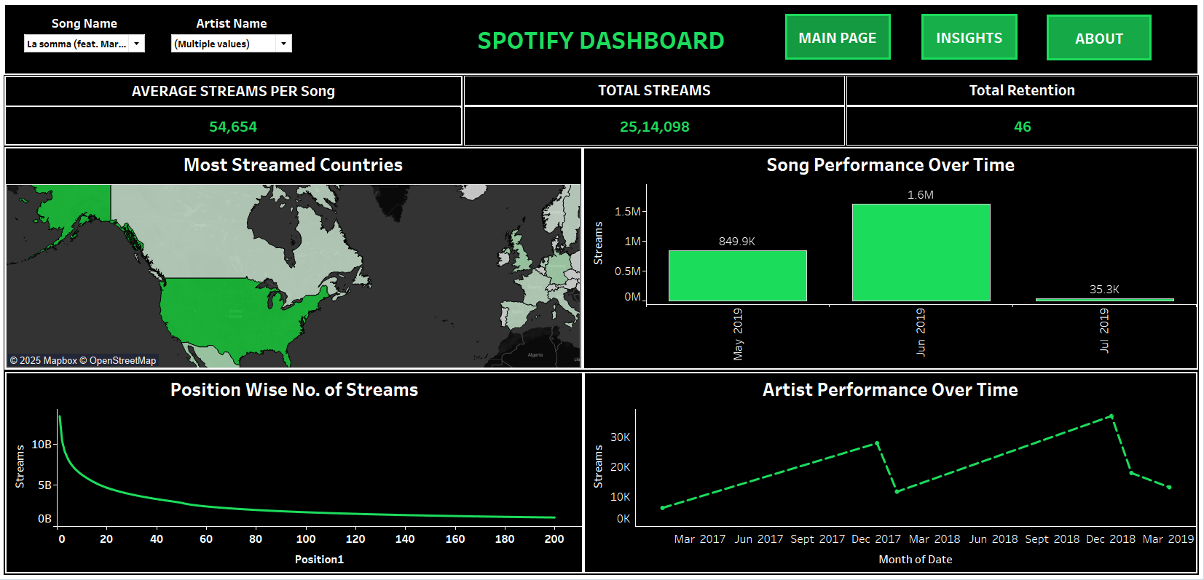
Visualization

Slide 9
Key Observations
Most Popular Artists & Tracks
Top Artists: Post Malone, Ed Sheeran and Drake had the highest number of streams.
Top Tracks: "Tilidin“, “Veleno 7” and " My Favourite Part - Remix" dominated the streaming charts.
Streams Over Time –
Streaming growth is evident from Dec 2016 (6.9B) to Dec 2018 (11.4B).
A sudden drop to 391.9M in June 2019 might indicate incomplete data or a platform shift.
Track Rank Over Time
Some tracks experience rapid rank improvement, while others decline over time.
Geographical Insights
The highest streaming activity was observed in North America, Europe, and parts of Asia.
Streams Distribution by Track Position
A high volume of streams is concentrated in the top-ranked tracks, while lower-ranked tracks receive significantly fewer streams.

Slide 10

Business Implications
Artist Strategy
Marketing Optimization
Revenue Maximization
Playlist Curation

Slide 11
Conclusion
The Spotify Dashboard provides valuable insights into music streaming trends, artist performance, and audience engagement. By leveraging data visualization, we can identify top-performing artists and tracks, monitor regional streaming trends, and optimize promotional strategies. This dashboard serves as a powerful tool for artists, record labels, and marketers to make data-driven decisions and enhance streaming performance. Future improvements could include AI-driven recommendations, sentiment analysis of user engagement, and predictive analytics for emerging artists.

Slide 12
References
Data Source: Spotify Streaming
Dataset Visualization Tool: Tableau
Additional Resources: Spotify API & Streaming Data Documentation

Slide 13

THANK YOU !

